Slide 1
6
INFINITE SEQUENCES AND SERIES
Copyright © Cengage Learning. All rights reserved.

Slide 2
6.3
The Integral and
Comparison Tests
Copyright © Cengage Learning. All rights reserved.

Slide 3


The Integral and Comparison Tests
In general, it is difficult to find the exact sum of a series.
We were able to accomplish this for geometric series and the series because in each of those cases we could find a simple formula for the nth partial sum s_{n}.
But usually it isn’t easy to compute
Therefore, in this section, we develop tests that enable us to determine whether a series is convergent or divergent without explicitly finding its sum.

Slide 4
The Integral and Comparison Tests
In this section we deal only with series with positive terms, so the partial sums are increasing.
In view of the Monotonic Sequence Theorem, to decide whether a series is convergent or divergent, we need to determine whether the partial sums are bounded or not.

Slide 5
Testing with an Integral

Slide 6
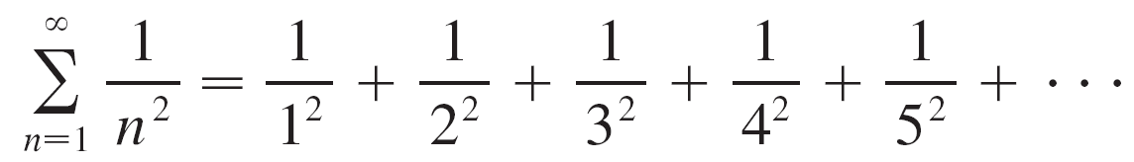
Testing with an Integral
Let’s investigate the series whose terms are the reciprocals of the squares of the positive integers:

Slide 7

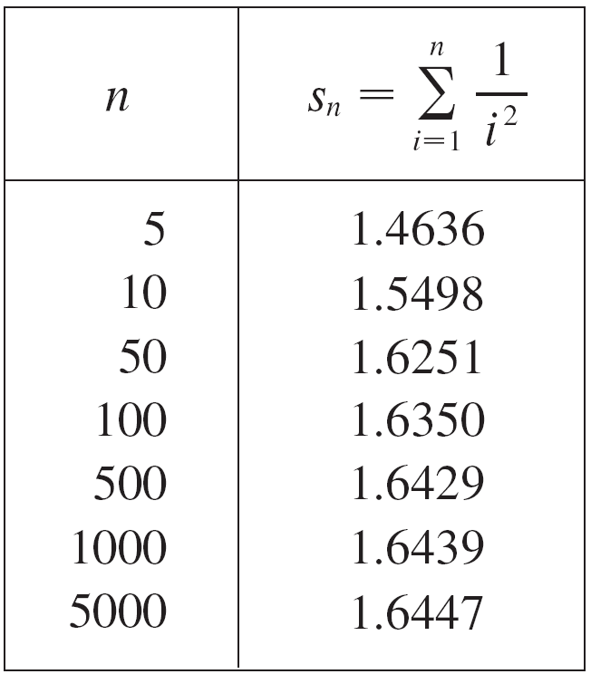
Testing with an Integral
There’s no simple formula for the sum s_{n} of the first n terms, but the computer-generated table of values given below suggests that the partial sums are approaching a
number near 1.64 as and so it looks as if the series is convergent.

Slide 8
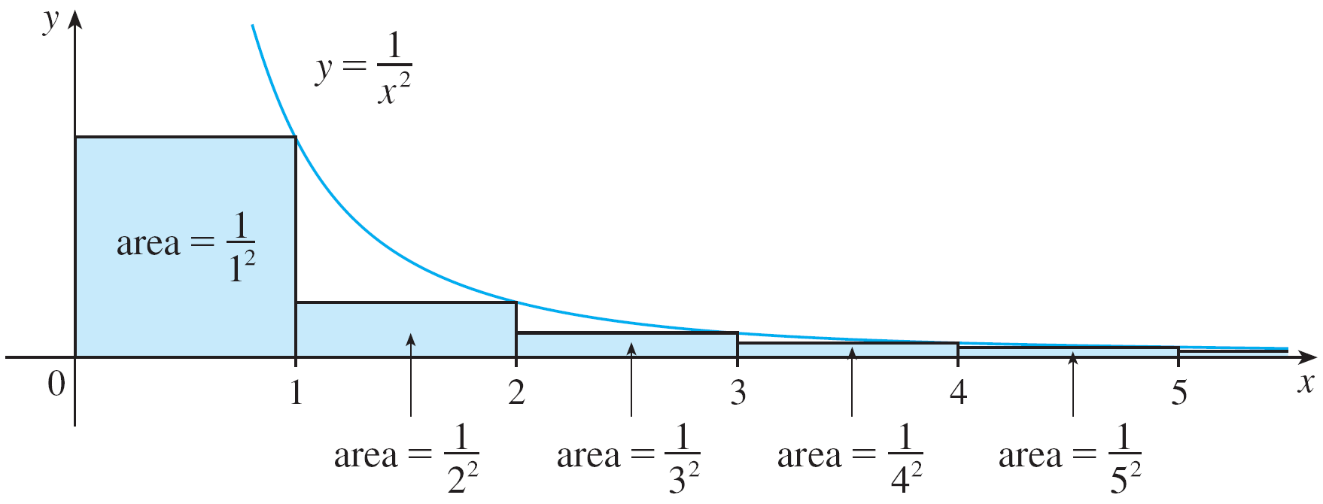
Testing with an Integral
We can confirm this impression with a geometric argument.
Figure 1 shows the curve y = 1/x² and rectangles that lie below the curve.
Figure 1

Slide 9
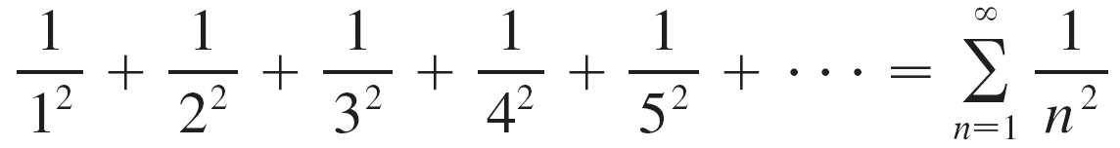


Testing with an Integral
The base of each rectangle is an interval of length 1; the height is equal to the value of the function y = 1/x² at the right endpoint of the interval.
So the sum of the areas of the rectangles is
If we exclude the first rectangle, the total area of the remaining rectangles is smaller than the area under the curve y = 1/x² for which is the value of the integral

Slide 10
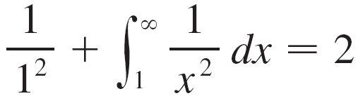
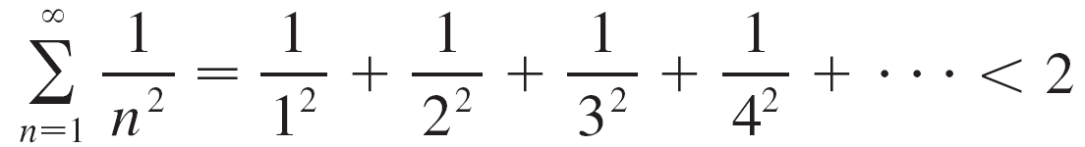
Testing with an Integral
We have discovered that this improper integral is convergent and has value 1.
So the picture shows that all the partial sums are less than
Thus the partial sums are bounded and the series converges. The sum of the series (the limit of the partial sums) is also less than 2:

Slide 11
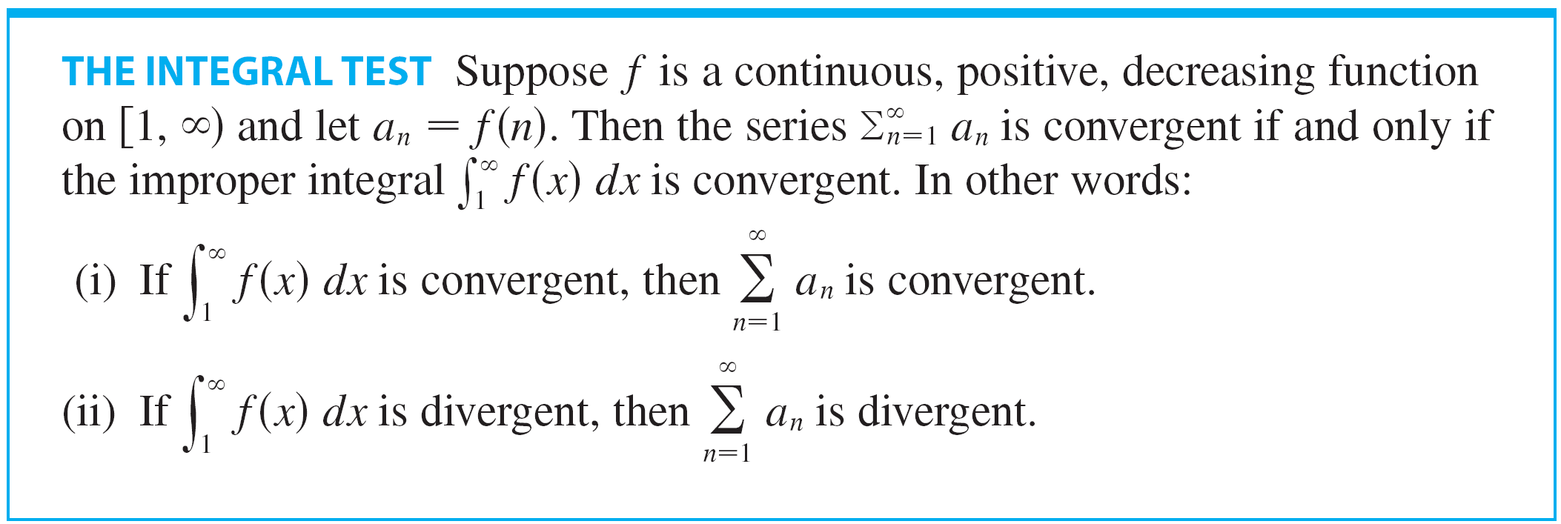
Testing with an Integral
The integral test is as follows:

Slide 12
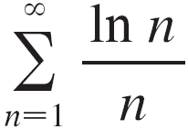
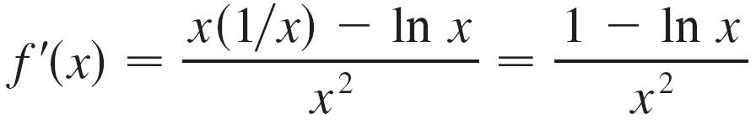
Example 1
Determine whether the series converges or diverges.
Solution:
The function f (x) = (ln x)/x is positive and continuous for
x > 1 because the logarithm function is positive and continuous there.
But it is not obvious whether or not f is decreasing, so we compute its derivative:

Slide 13
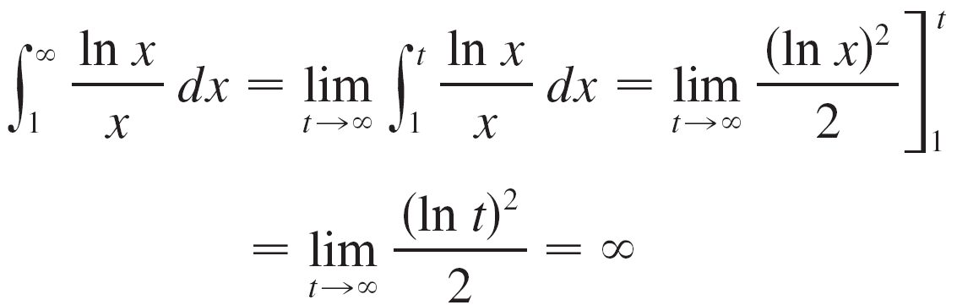
Example 1 – Solution
cont’d
Thus f ′(x) < 0 when In x > 1, that is, x > e.
It follows that f is decreasing when x > e and so we can apply the Integral Test:

Slide 14

Example 1 – Solution
cont’d
Since this improper integral is divergent, the series is also divergent by the Integral Test.

Slide 15
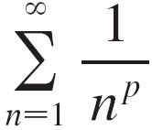

Testing with an Integral
The series is called the p-series.
The following tables shows that if p > 1 then the p-series is convergent and if p ≤ 1 then the p-series is divergent.

Slide 16
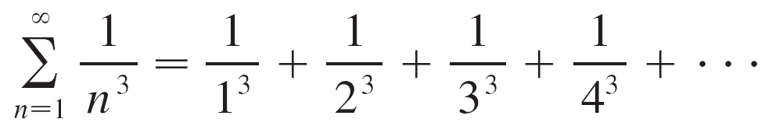
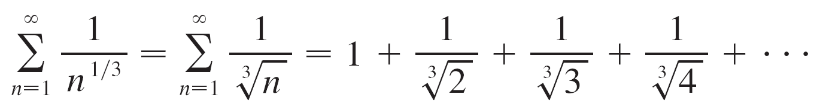

Testing with an Integral
For instance, the series
is convergent because it is a p-series with p = 3 > 1.
But the series
is divergent because it is a p-series with

Slide 17




Testing with an Integral
Suppose we use the Integral Test to show that a series
is convergent, and we now want to find an approximation to
the sum s of the series.
Any partial sum is an approximation to s because
How good is the approximation? We estimate the remainder
This remainder is the error of the approximation .

Slide 18

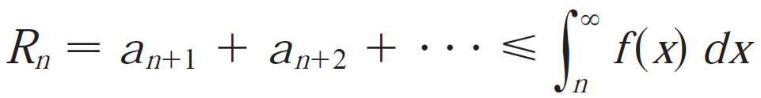
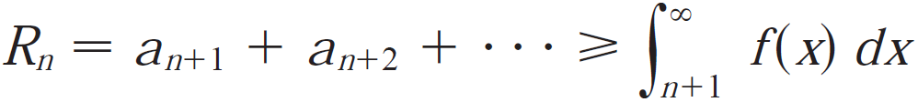
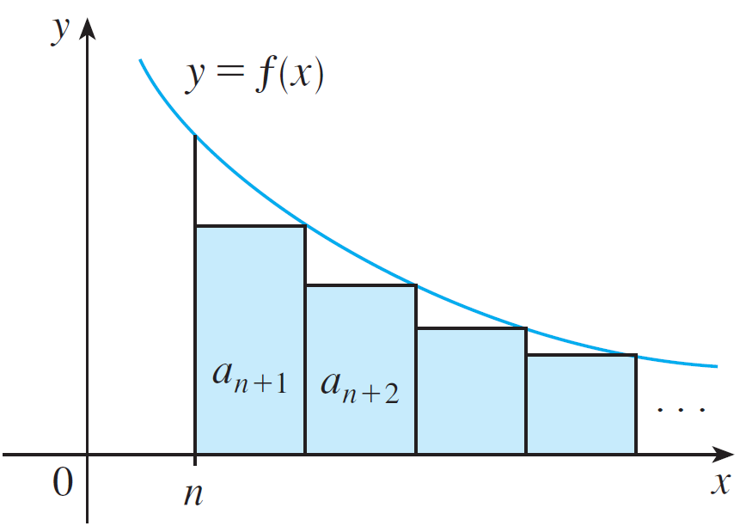
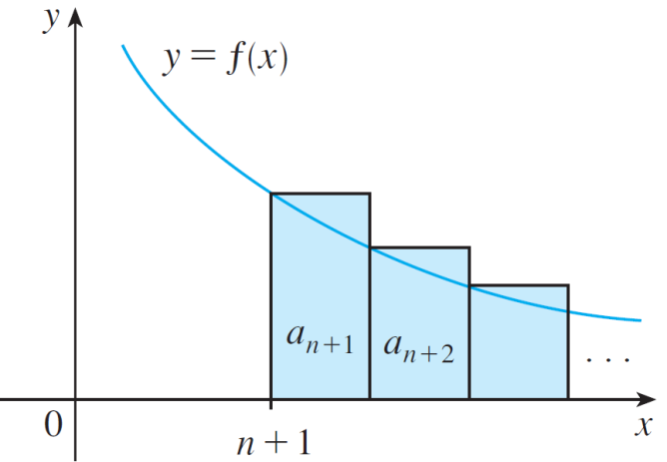
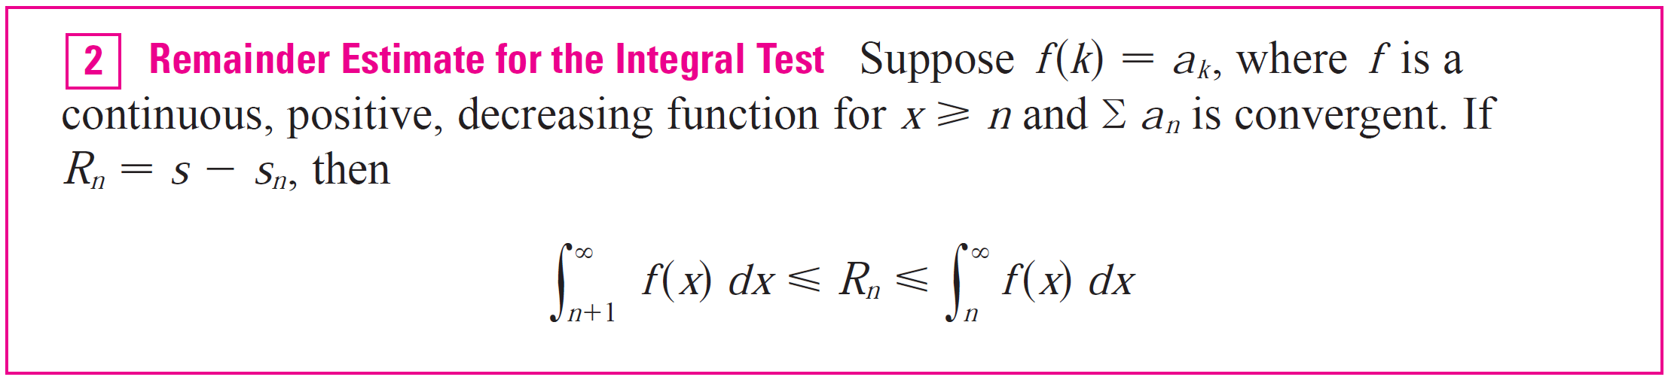
Testing with an Integral
We use the same notation and ideas as in the Integral Test,
assuming that f is decreasing on

Slide 19
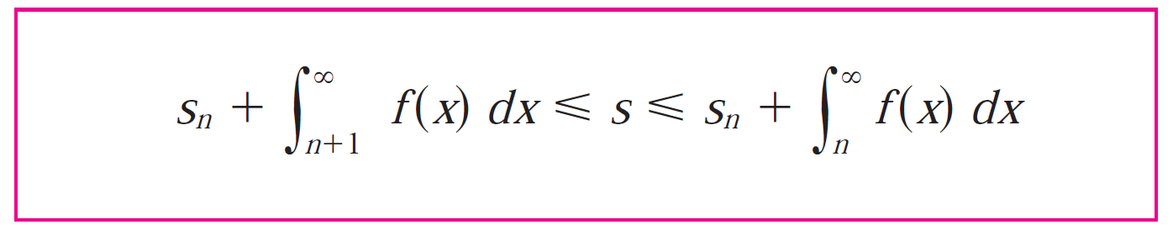


Testing with an Integral
If we add to each side of the inequalities of , we get
because These inequalities give a lower bound
and an upper bound for s. They provide a more accurate
approximation to the sum of the series than the partial sum
does.

Slide 20
Testing by Comparing

Slide 21
Testing by Comparing
The following comparison test, which applies only to series whose terms are positive.
The first part says that if we have a series whose terms are smaller than those of a known convergent series, then our series is also convergent.
The second part says that if we start with a series whose terms are larger than those of a known divergent series, then it too is divergent.

Slide 22
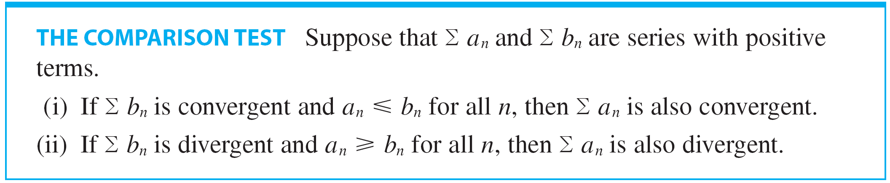

Testing by Comparing
Standard Series for Use with the Comparison Test
In using the Comparison Test we must, of course, have some known series for the purpose of comparison.

Slide 23


Testing by Comparing
Most of the time we use one of these series:
A p-series [ converges if p > 1 and diverges if
p ≤ 1]
A geometric series [ converges if | r | < 1 and diverges if | r | ≥ 1].

Slide 24
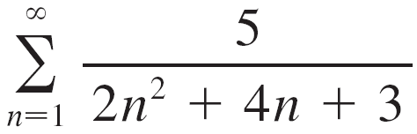

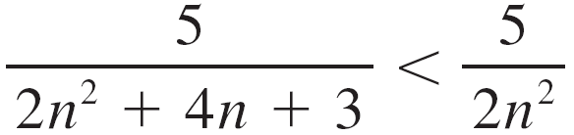
Example 3
Determine whether the series converges or diverges.
Solution:
For large n the dominant term in the denominator is 2n², so we compare the given series with the series
Observe that
because the left side has a bigger denominator.

Slide 25
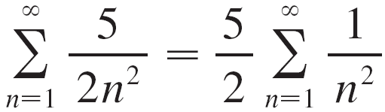
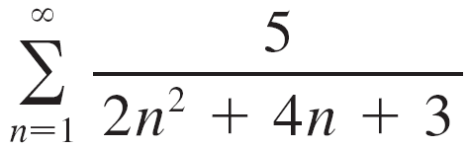
Example 3 – Solution
cont’d
In the notation of the Comparison Test, a_{n} is the left side and b_{n} is the right side.
We know that
is convergent (p-series with p = 2 > 1).
Therefore
is convergent by part (i) of the Comparison Test.

Slide 26
Testing by Comparing
Although the condition a_{n} ≤ b_{n} or a_{n} ≥ b_{n} in the Comparison Test is given for all n, we need verify only that it holds for
n ≥ N, where N is some fixed integer, because the convergence of a series is not affected by a finite number of terms.
The terms of the series being tested must be smaller than those of a convergent series or larger than those of a divergent series.
If the terms are larger than the terms of a convergent series or smaller than those of a divergent series, then the Comparison Test doesn’t apply.

Slide 27
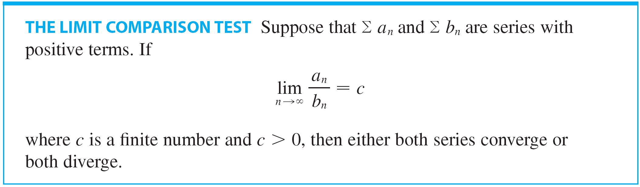
Testing by Comparing
In such cases the following test can be used.

Slide 28
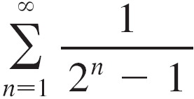
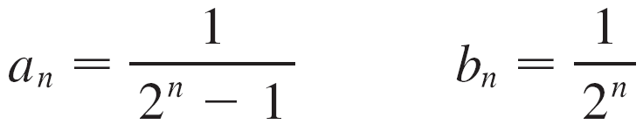
Example 5
Test the series for convergence or divergence.
Solution:
We use the Limit Comparison Test with
and obtain

Slide 29

Example 5 – Solution
cont’d
Since this limit exists and is a convergent geometric series, the given series converges by the Limit Comparison Test.

Slide 30

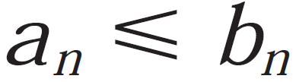
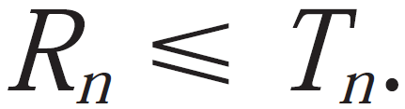
Testing by Comparing
We consider the remainder
For the comparison series we consider the corresponding
remainder
Since for all n, we have

Slide 31
Proof of the Integral Test

Slide 32

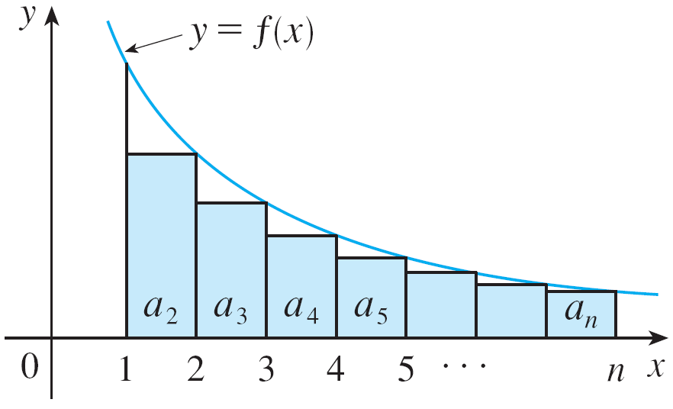
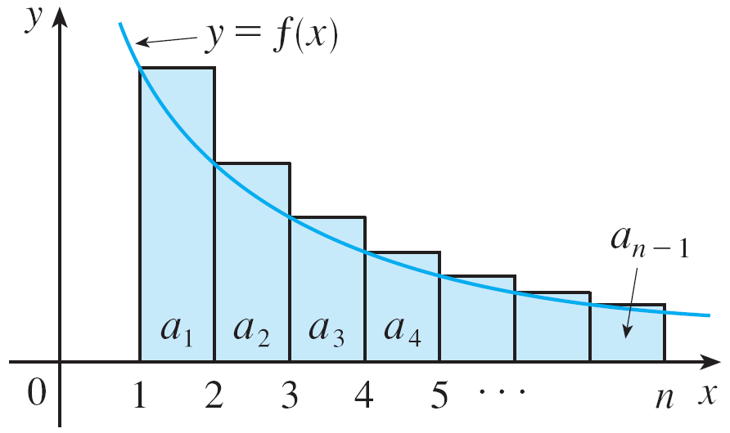
Proof of the Integral Test
For the general series look at Figures 3 and 4.
The area of the first shaded rectangle in Figure 3 is the value of f at the right endpoint of [1, 2], that is, f (2) = a₂.
Figure 3
Figure 4

Slide 33

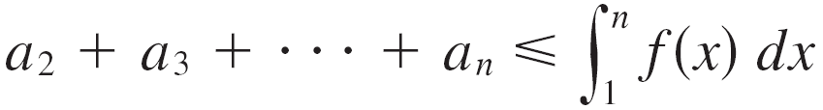

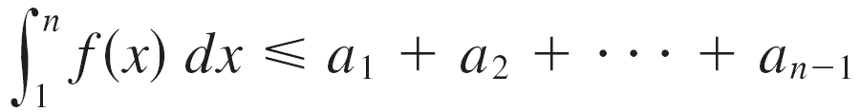
Proof of the Integral Test
So, comparing the areas of the shaded rectangles with the area under y = f (x) from 1 to n, we see that
(Notice that this inequality depends on the fact that f is decreasing.)
Likewise, Figure 4 shows that

Slide 34
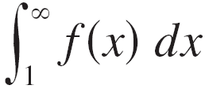

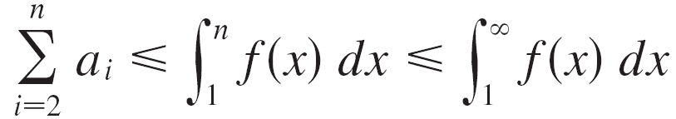
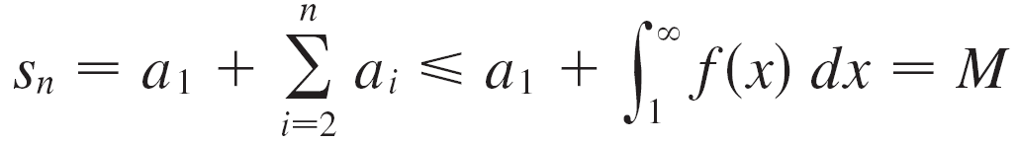
Proof of the Integral Test
(i) If is convergent, then gives
since f (x) ≥ 0. Therefore
where M is a constant.

Slide 35

Proof of the Integral Test
Since s_{n} ≤ M for all n, the sequence {s_{n}} is bounded
above. Also
since
Thus {s_{n}} is an increasing bounded sequence and so it
is convergent by the Monotonic Sequence Theorem
(which says “Every bounded, monotonic sequence is
convergent.”)
This means that is convergent.

Slide 36



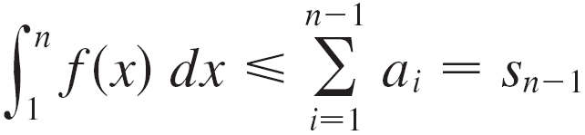


Proof of the Integral Test
(ii) If is divergent, then as
because f (x) ≥ 0.
But gives
and so This implies that and so
diverges.

